Slide 1
Progress Vlog #5
URStreamSight
Avery Cameron, Raymond Knorr, Noah Rowbotham
March 18, 2021
Notes:
AVERY

Slide 2
Team Members
Avery Cameron
Project Management/Flexible Developer
Help with Front-End and ML as needed
Raymond Knorr
Lead API and Front-End Developer
Manage collaboration with Prairie Robotics
Noah Rowbotham
Lead Machine Learning Technician
Lead development of classification model and documentation
Notes:
Avery Cameron: Project Manager/Flexible Developer
Manage our GitHub structure and CI/CD
Organize project meetings and milestones
Manage project documentation
Help with Front-End and ML as needed
Raymond Knorr: Lead UI/API Developer
Manage integration and documentation of our software with Prairie Robotics
Manage Trello board for workflow organization
Manage communications between URStreamSight & PrairieRobotics
Noah Rowbotham: Lead Machine Learning Technician
I lead development of machine learning training and implementation
I manage the integration of Amazon services with our ML workflow
I develop on the aaeon onboard computer which facilitates the collection of data from recycling collection vehicles

Slide 3
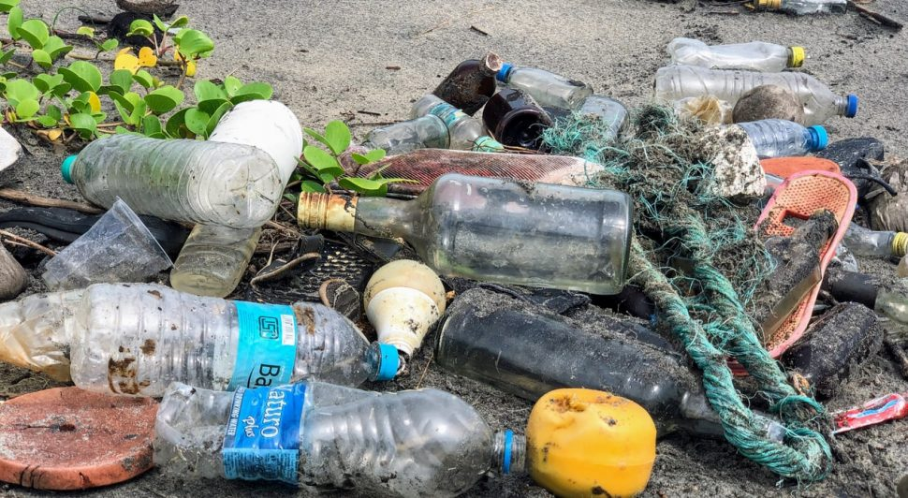
What is URStreamSight?
Problem:
Citizens across Canada are confused what proper recycling is
Sorting recycling is extremely costly
Gap we are filling:
Providing data to municipalities allowing them to track/correct problem at its source (the people recycling).
Innovation we are introducing:
Platform for municipalities that provides reporting for discovering contamination origins. Meant to provide data on specific areas or neighborhoods
Machine learning used to classify contaminants within a bin of recycling
Notes:
Avery
Web application for municipality workers that scores recycling data on a neighborhood basis and displays the data. Videos are captured from the bin of recycling trucks and ran through a waste classifier to determine whether the recycling is contaminated.
This is a web application for municipality workers to review contamination in recycling bins and display reports to help with decision making. Pictures are captured when a bin is tipped into the recycling truck and contamination is identified with machine learning, this is then displayed in our front end portal for users.

Slide 4
The Why
Contaminated recycling generates fines for municipalities
Fines increase costs for households
Clean recycling generates profits and lowers costs for households
Sorting recycling is complicated and expensive
Instead of reacting to recycling contamination by removing it or paying fines, being proactive through education will reduce contamination long term
This is all based on various studies on recycling contamination impacts such as a Study from the Region of Peel (in Ontario) showed that after education campaigns, 90% of people had less than 10% contamination compared to 60-70% of people before.
By educating, influencing, and reprimanding when required we can clean recycling at the source increasing revenues, lowering household expenses, and improving recycling effectiveness which in turn promotes a greener future.
Notes:
Contaminated recycling generates fines for municipalities which increases costs for households. If the recycling is clean, recycling can provide revenue for the municipality which will lower costs for households.
Instead of reacting to recycling contamination by removing it through sorting, this project is proactive. Being proactive is a more permanent solution, education campaigns then reduce contamination at the source instead of relying solely on sorting.
This is all based on various studies on recycling contamination impacts such as a Study from the Region of Peel showed that after education campaigns 90% of people had less than 10% contamination compared to 60-70% of people before the campaign.
To summarize: by educating, influencing, and reprimanding when required we can clean recycling at the source increasing revenues, lowering household expenses, and improving recycling effectiveness which in turn promotes a greener future. This is why we are developing URStreamSight.

Slide 5
Scrum Dates
March 5, 2021 to March 18, 2021
Notes:
This scrum ran from Feb 5, 2021 - Feb 25, 2021

Slide 6

Status Description
API - Green
Testing - Yellow
Front end - Green
Machine Learning - Yellow-Green
Image Pipeline - COMPLETE
Overall - Green
Notes:
API Status: Green
The API is complete and is now hosted on AWS with automated deployment with Serverless Framework via GitHub Actions. We also introduced a AWS Lambda function that takes results from our ML model and places them into the database from SQS. We are adding tests to the API and we are looking at doing load tests and other performance tests if there is time in the next couple weeks.
Testing Status: Yellow
We have been focusing our energy on the main aspects of our MVP, and are planning on coming back and finishing testing once everything else is functional. This will include running tests in our CI/CD pipeline and generating coverage reports.
Frontend Status: Green
Our frontend is still hosted on AWS and GitHub Actions has been working well and keeping it up to date.
Machine Learning: Yellow-Green
We have a functioning computer vision model in place that was trained on our image pipeline with the help of Prairie Robotics. We are exploring other avenues to try to improve performance. Currently, machine learning is yellow because the ec2 instance we are using from amazon to train our model is having technical difficulties. This issue has halted training progress, but by Friday I am hoping to have it resolved and spend Saturday, Sunday, Monday training new model variations. Since training only takes approximately 1 to 2 hours, three days should be plenty of time to see some good results prior to Thursday, assuming no more technical issues arise.
Image Pipeline: Complete

Slide 7
Team Member Contribution
Avery
AWS Configuration
Front end deployment
Back end deployment
Ray
Front end pages / sign-in flow
API token validation
Generating mock data
Noah
ML goals clarification
Contaminant classifier training
Notes:
Avery:
Over this scrum I worked on fixing the API deployment issue and getting it deployed to AWS. I also updated our GitHub Actions. I also worked on Infrastructure as Code to help create resources on AWS quickly and help with future deployments for Prairie Robotics.
Ray:
This scrum, I was working on a AWS Lambda function that takes data from our ML model and puts it into our cloud database. I also investigated an issue causing our authentication to fail on the cloud API. This was fixed.
Noah:
I’ve spent the last scrum working on clarifying our goals for our machine learning and trying to train our contaminant detection model.

Slide 8
Project Issues and Changes
None at this time

Slide 9
Project Demo
GitHub Actions| SQS Lambda | Front-end
Notes:
(AVERY GOES FIRST RAY)
CI/CD:
Github Actions
Front-end
Demo of sign-in flow and different pages within the hosted app.

Slide 10
Project Demo
Contaminant Classification
Notes:
Contaminant Classification

Slide 11
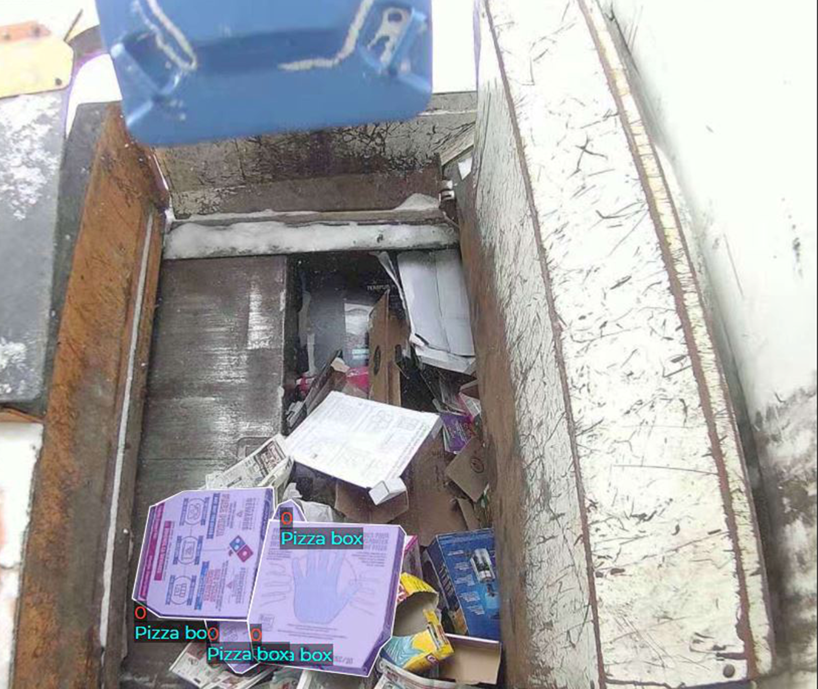
Annotation Example
Notes:
This is what our training data looks like after being annotated. In this example, three pizza boxes have been labeled and bound as a contaminant present in this household recycling.

Slide 12
Plans For Next Scrum
Ray
API Performance and integration
Finish API testing
Avery
Adding tests
Infrastructure as Code
Noah
Contaminant classifier training
Notes:
Ray: I plan on working on speeding up the hosted API, and also making sure that the hosted front-end, API, and DB, all are working together.
Avery: I plan on adding more tests to the API and adding tests and test coverage to our CI/CD pipeline. I am also going to work on some additional tasks related to Infrastructure as Code to help with deployment of AWS services for Prairie Robotics
Noah: I am continuing to work on training a contaminant classifier.

Slide 13
Group reflection
Do you feel you are on track?
Yes, we feel we are green overall, and having our API and frontend primarily done is great.
What progress does the team feel particularly great about?
We feel great about the deployment of the API and the Lambda SQS project to take in machine learning results
Do you feel there are barriers to your success (if any)?
Pressures of other courses are possible barriers. Our model training could delay progress but at the moment things are going smoothly.
Do you need any help going forward?
We will continue to meet with Dr. El-Darieby and Sam for feedback.
Any other questions or concerns?
When do you need access to our code by? Do other faculty members need access as well?
We helped create the data input and make design choices about the ML model, but the training was done by PR. Is it okay that we leverage that model in our project pipeline? Especially since the code used from training is not unique, it is standard cookie-cutter code from the PyTorch documentation.
Notes:
Ray does first two,
Noah does next two,
Avery does last one
Was this level of description of our project understandable
Was this level of description of our project understandable

Slide 14
References
https://cleanriver.com/how-to-reduce-recycling-contamination/
https://i.pinimg.com/originals/e9/2c/79/e92c79bbf86dd1295f94bb279fe7152a.jpg
Region of Peel - Study on Enforcement for Reducing Blue Bin Contamination
https://pub-peelregion.escribemeetings.com/FileStream.ashx?DocumentId=4482

Slide 15
Questions or Comments?

